Slide 1
Always Learning

Slide 2
CHAPTER 11
HVAC System Inspection and
Trouble Diagnosis Procedures

Slide 3
OBJECTIVES
After studying Chapter 11, the reader will be able to:
Inspect an HVAC system to determine whether it is operating correctly, and if not, to make further tests to locate the faulty subsystem and the cause of the problem.
Check HVAC system temperatures and determine if they are correct.
Follow a logical procedure to locate the cause of a problem in an HVAC system.
Complete the Automotive Service Excellence (ASE) tasks related to HVAC inspection and test procedures.

Slide 4
KEY TERMS
After-blow module
Comeback
Diagnostic trouble code (DTC)
Electronic evaporator dryer (EED)
Functional test
Groundout
Technical service bulletin (TSB)
Trouble tree
Visual inspection

Slide 5
INTRODUCTION
Except for preventive maintenance operations, HVAC system repair should begin with a systematic procedure to determine exactly what is wrong.
If trouble diagnosis is thorough and accurate, all problems can be located and repaired at the same time.
An important step in the early part of the diagnostic procedure is to ensure that there is a problem and, if there is, to determine which HVAC subsystem is at fault.

Slide 6
TECH TIP
Refrigerant must be recovered from an A/C system before repairs can be made; after the repairs are complete, the system must be recharged. An incomplete or inaccurate diagnosis usually leads to an incomplete repair, which may mean going through the recovery and recharge steps twice, wasting time and possibly some refrigerant.

Slide 7
TECH TIP
A competent technician normally makes several diagnosis checks of a system. Diagnosis usually begins with a thorough under-hood inspection using sight, sound, touch, and even smell. Under-hood checks usually begin with an inspection while the engine is off, and parts of this check are repeated with the engine running. The inspection procedure also includes a check of the HVAC system controls, blower, and air management doors both while the engine is off and while it is running. After these checks, the technician should know whether the system is operating properly or which subsystem has a problem.

Slide 8
TECH TIP
Experienced technicians realize that the customer expects the HVAC to work reliably for a period of time after he or she has worked on it. All potential problems should be brought to the customer’s attention. These can include worn drive belts, a partially clogged condenser, and wires or refrigerant lines that are contacting things that they shouldn’t be.

Slide 9
HVAC SYSTEM INSPECTION
HVAC system inspection, often called a visual inspection or a functional test , is the quickest way to locate obvious problems.
SEE FIGURE 11–1 .
It also gives the technician a good idea of the overall condition of the system.
A/C SYSTEM INSPECTION

Slide 10
TECH TIP
A missing A/C service cap can allow a refrigerant leak of up to 1 lb (2.2 kg) of refrigerant per year.

Slide 11
REAL WORLD FIX
The 1992 Dodge Caravan (140,000 miles) had a failure of the serpentine belt that unraveled and caused a failure of the A/C drive belt. The belts had been replaced, but then the A/C clutch would not engage. The fuses were okay, but there was no power to the clutch.
Following advice, the technician checked the pressure switch that is mounted on an A/C line below the radiator and found the flapping belt had disconnected the wire connections. Replacement of these wires onto their connectors fixed this problem.

Slide 12
TECH TIP
On many cars, a “thunk” noise occurs as the temperature door contacts the stop. If you are in an area with cold winters, make sure it “thunks” at the full heat stop; if you are in an area with hot summers, make sure it “thunks” at the full cool stop.

Slide 13
REAL WORLD FIX
The 1988 Buick (73,000 miles) had very little airflow from the registers. The programmer was checked, and the solenoids appeared to be functioning. A new programmer was installed, but this did not help. Changing the operating mode produced the same amount of airflow from each outlet.
Following advice, the evaporator core was checked and found to be plugged almost solid. It had been leaking, and the refrigerant oil had collected a lot of dirt. Replacement of the evaporator core fixed this problem as well as an A/C problem. A good review of HVAC basics would have saved the unneeded replacement of the programmer.

Slide 14
TECH TIP
Reduced airflow can be caused by a plugged evaporator core. This can be checked by measuring the blower motor current draw. Any restriction to the airflow will reduce the power requirement for the blower motor and the amount of current required. A more complete explanation can be found in Chapter 14 .

Slide 15
REAL WORLD FIX
The 1996 Ford Explorer (50,000 miles) had a faulty blend door actuator motor. A new motor was installed, but it did not operate the door. The power supply and ground checked good, and the motor could be made to operate. After determining that the new motor was the wrong part for this vehicle, even though it looked the same, the correct motor was installed, but it still would not operate the door.
Closer inspection revealed that the blend door operating shaft had broken off. Installation of a new, updated heater box/blend door assembly fixed this problem.

Slide 16
REAL WORLD FIX
The 1986 Saab (170,000 miles) HVAC system had no temperature control; it stayed at a constant, hot temperature. The stepper motor operated the arm attached to the blend door in what appeared to be a normal manner.
Following advice from other technicians, the system was disassembled. The sealing foam from the blend door had disintegrated, and a large piece had fallen down and jammed the door. This caused the door operating arm to break. Replacement of the plenum section fixed this problem.

Slide 17
REAL WORLD FIX
The 1993 Pontiac Bonneville (120,000 miles) had a very poor airflow from the instrument panel registers. This was a manual system so there was no scan tool information. The technician was concerned about removing the instrument panel to locate the problem.
Following advice, the glove compartment seals were checked and found to be faulty. Another faulty seal was also found after the radio was removed. Repair of these two air leaks fixed this problem. Some vehicles route the instrument panel air through the glove compartment.

Slide 18
TECH TIP
Radios and glove compartments are often easy to remove, and the opening provides a way to inspect hidden areas behind the instrument panel.

Slide 19
TECH TIP
With the hood and driver’s door or window open, on most vehicles you can hear an audible click as the compressor clutch engages when you turn the A/C system on. Set the system to A/C, cold temperature, and high blower speed. With electronically controlled systems, the engine must be running for the A/C clutch to operate.

Slide 20
TECH TIP
An infrared, noncontact thermometer is a fast and easy way to check system temperatures (see Figure 12–2 ).

Slide 21
TECH TIP
To determine if there is adequate airflow through a condenser, many technicians place a sheet of paper or a dollar bill in front of the condenser; with the engine running at idle speed, it should stick there.

Slide 22
TECH TIP
Automatic operation of the ATC system can be checked by warming the in-vehicle sensor with a heat gun (it should shift to a colder operation), cooling the sensor with a quick-freeze aerosol (it should shift to a warmer operation), or bringing a lightbulb over the sunload sensor (it should shift to a colder operation).

Slide 23
TECH TIP
An in-car sensor must have an airflow past it in order to measure the temperature. This airflow is caused by the aspirator or an integrated fan. You can test the airflow by placing a piece of tissue paper next to the sensor; the paper should be held in place by the air pressure.

Slide 24
TECH TIP
A low refrigerant charge level can cause no compressor operation, compressor short-cycles, and low system pressures. It can also cause the compressor to run hotter than normal and possible early compressor failure.

Slide 25
REAL WORLD FIX
The 1988 Dodge Caravan (130,000 miles) had a complaint of no heat from the heater. The engine thermostat was working, and the engine coolant was getting hot. The heater hoses were hot, but the technician was concerned that there was no vacuum signal to the heater control valve.
A check of a vacuum diagram showed that a vacuum signal was only at the valve during A/C to close the valve. Following advice, the technician checked the temperature blend door, and it was found to be stuck. A small hole was drilled into the plenum case at the lower bearing for the door, and penetrating oil was sprayed into the hole. This freed the door and fixed the problem.

Slide 26
PROBLEM DIAGNOSIS
A visual inspection often locates the exact cause of a problem.
It nearly always reveals the nature of the problem, showing in what area of the system the problem lies.
If there is no blower motor operation along with no compressor clutch operation, for example, an experienced technician knows that in many vehicles these are branches of a single electrical circuit.
Therefore, the most probable cause is a blown fuse; the second-most-probable cause is either a faulty switch at the control head or a bad connection to that switch.

Slide 27
HVAC SYSTEM PROBLEMS
SYSTEM ODORS
NOISE PROBLEMS

Slide 28
TECH TIP
A complaint of uneven air discharge temperature from the instrument panel registers (cold on one side and warm on the other) can be caused by a low charge level. This will cause some parts of the evaporator to be cold while others are warm. It is possible for the air from the cold side to flow to a single register.

Slide 29
REAL WORLD FIX
The 1995 Chevrolet Lumina (60,000 miles) came in with a complaint of no A/C. The system appeared to be low on refrigerant so it was leak tested, the refrigerant recovered and recycled, and the system evacuated and recharged. The high- and low-side pressures were then okay, but the air coming from the ducts was not cold. An under-dash check showed vacuum at the proper location, and the blend door seemed to be working.
A closer under-dash inspection revealed an ink pen blocking complete movement of the blend door lever; removal of the ink pen fixed this problem.

Slide 30
REAL WORLD FIX
The 1999 GMC Yukon (24,000 miles) had a wet floor on the passenger side. The A/C was not draining to the outside, and the technician could not find the drain.
Following advice, the technician checked the proper location and found that the drain hose was missing and that the drain was plugged. Cleaning the drain and installing a new drain hose fixed this problem. Some vehicles have drains that are very difficult to locate; for example, one vehicle drains the HVAC case to the inside of a body frame member.

Slide 31
TECH TIP
In some systems, spraying a liquid into the inlet of ductwork simply wets the blower fan and does very little good. It is much better to spray the material onto the evaporator fins. With some systems, fairly good access can be obtained by removing the blower motor resistor or blower motor; other systems require drilling a properly placed hole, which must be covered when you are finished. Be sure to follow the manufacturer’s procedure and wear the required safety gear; most solutions require a face shield or goggles, and some require a respirator.

Slide 32
TECH TIP
Bacterial growth can be prevented by regularly drying off the evaporator. Running the system on vent or heat with the A/C off is a good way, but most people do not want to do this on a hot day. Sometimes just turning the A/C off shortly before the car is parked will let the high-side pressure bleed off, so the evaporator will warm up slightly and dry off faster.

Slide 33
TECH TIP
Bacterial-growth odor can be prevented by operating the A/C in fresh air mode rather than recirculation. The moisture from the outside air collects on the evaporator core and can wash the growth off the core.

Slide 34
TECH TIP
Groundout problems are cured by either separating the A/C lines from the other surface or clamping them together.

Slide 35
TECH TIP
When there is a suspected noise problem with a compressor, the first check is to note the noise change with the clutch engaged and disengaged. If the noise stops with the clutch disengaged, the problem must be caused by the compressor; if the noise continues, it could be the clutch bearing. The second check is to (1) feel for a vibration by touching the area next to the clutch (a noisy part vibrates at a frequency that matches the noise frequency) or (2) remove the drive belt (if the noise stops, one of the items driven by that belt was making the noise). The chart can help you locate the cause of other noise problems.

Slide 36
TECH TIP
A high-pitched noise from the area of the compressor clutch that occurs during engagement can indicate a weak clutch. Check for proper voltage at the clutch, an excessive clutch air gap, or excessive high-side pressure. This noise can also be caused by a loose or misaligned drive belt. With serpentine belts, check to make sure the automatic tensioner is operating correctly.

Slide 37
Objectives
Identify the low and high side of the air conditioning system.
Diagnose six system malfunctions by gauge readings.
Read and understand temperature-pressure charts.
Discuss temperature-pressure relationships.
Identify the differences between R-134a and R-12 systems.
Understand the proper handling of refrigerants.
Understand the proper handling of refrigerant oil.

Slide 38
Objectives
Determine if the air conditioning malfunction is due to an electrical or mechanical failure.
Determine the “state-of-charge” of refrigerant in the air conditioning system.
Perform functional testing of the electrical and mechanical systems.
Understand general troubleshooting procedures and practices.

Slide 39
Start the Diagnostic Process by Following a Logical Systematic Approach

Slide 40
Identify System Pressure Review
Low to high pressure at compressor
High-pressure side
Compressor output
Condenser
Receiver dryer (if equipped)
High-side gauge
High to low at metering device
Low-pressure side
Metering device output
Evaporator
Accumulator (if equipped)
Low-side gauge

Slide 41
Temperature Versus Pressure
For a given temperature, there is a given pressure.
For a given pressure, there is a given temperature.
If ambient temperature is known, then the refrigerant pressure and temperature can be charted.

Slide 42
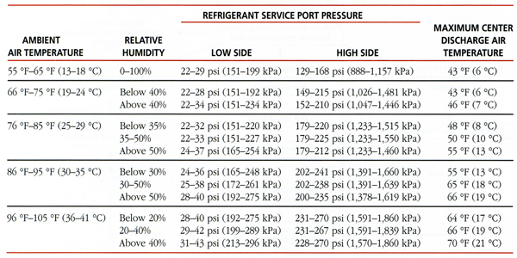
Performance Table

Slide 43
System Condition Status
There are generally 7 basic system conditions. Normal operation and Six basic malfunctions identified by gauge.
1. Normal Operation
2. Insufficient cooling: low side low, high side normal
3. Insufficient cooling: low side low to very low, high side low
4. Insufficient cooling: low side low, high side high to extremely high
5. Insufficient cooling: low side high, high side low
6. Insufficient cooling: low side high, high side normal
7. Insufficient cooling: low side high, high side high to extremely high

Slide 44
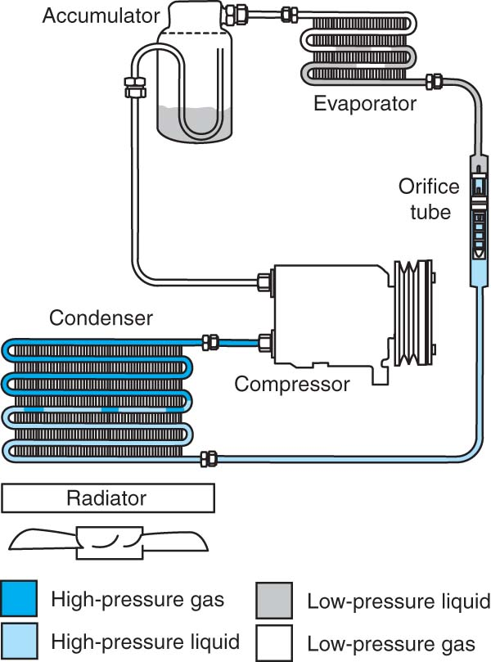
Condition 1 Normal Operation
Normal conditions
Both high- and low-side gauges showing normal pressures

Slide 45
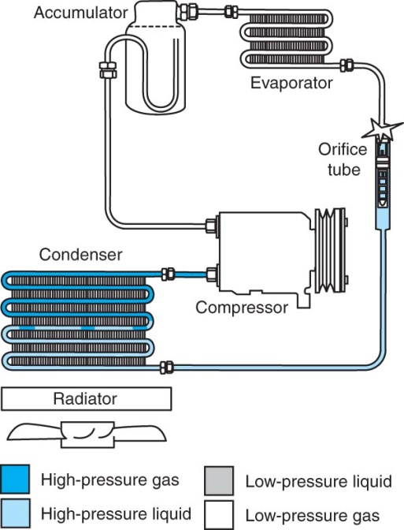
System Malfunctions Condition 2
Insufficient cooling
Gauge readings
Low-side low
High-side normal
Possible causes
Restriction on Low side of system
Moisture in system
TXV malfunction-which limits refrigerant flow will cause evaporator refrigerant starvation resulting in insufficient cooling.
Restricted orifice tube causing evaporator starvation.

Slide 46
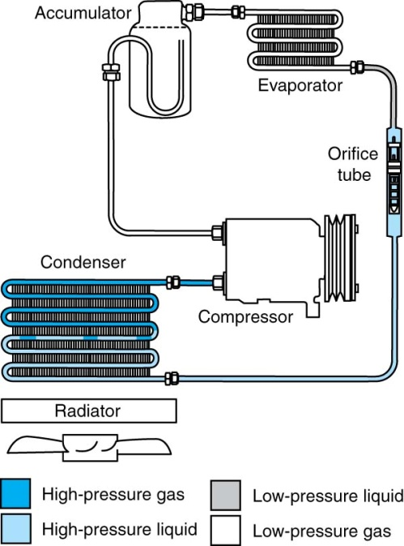
System Malfunctions Condition 3
Insufficient cooling
Gauge readings
Low-side low to very low
High-side low
Possible causes
Clogged inlet screen or FOT restricted
Defective TXV
Low refrigerant charge level (inspect for leak)
High side restriction

Slide 47
System Malfunctions Condition 4
Insufficient cooling
Gauge readings
Low-side low
High-side High to extremely high
Possible causes
Restriction high side of system
The higher the high-side pressure the closer the restriction is to the compressor
Moderately high, high-side pressure may be restricted receiver dryer or liquid line
Look for temperature change at restriction point
A system that has too much refrigerant oil may also exhibit these symptoms. Lines may also be vibrating or pulsating.

Slide 48
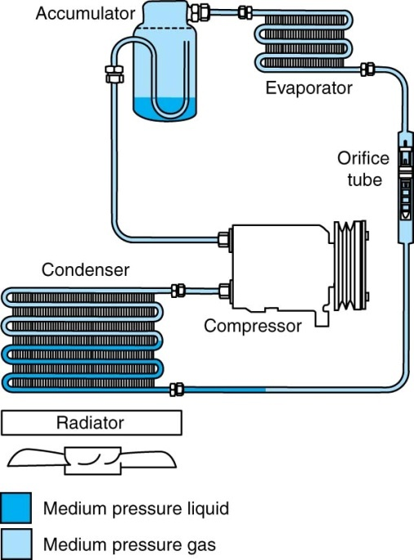
System Malfunctions Condition 5
Insufficient cooling
Gauge readings
Low-side high
High-side low
Possible causes
Low refrigerant charge level
Electrical malfunction
Pressure switch
Ambient air temperature switch (will not allow AC to operate below a predetermined temperature)
Fin sensor (evaporator temperature sensor)
Inspect – is compressor turning?
Mechanical
Defective compressor clutch or coil
Defective compressor (valve plate, piston rings, etc.) Evaporator outlet and all lines warm to the touch. Both low-and high-side pressures equalize quickly after turning compressor off.
Inspect – listen for noises from compressor, erratic engagement indicates a compressor clutch or circuit problem.

Slide 49
System Malfunctions Condition 6
Insufficient cooling
Gauge readings
Low-side high
High-side normal
Possible causes
This condition is generally only found on TXV systems
TXV not closing or remote bulb is not contacting evaporator outlet tube
Also if a blend door is open on an upstream heater core hot air could be flowing across evaporator core.

Slide 50
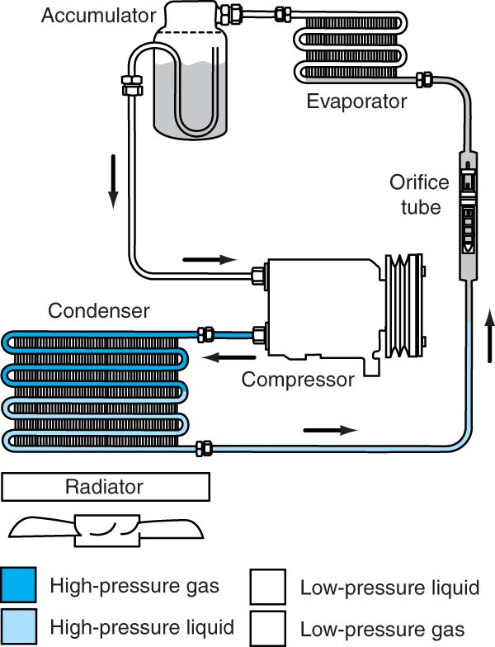
System Malfunctions Condition 7
Insufficient cooling
Gauge readings
Low-side high
High-side high to extremely high
Possible causes
Air contaminated system (non-condensable gas)
Over charge of refrigerant
Incorrect refrigerant (contaminated)
Condenser fan not turning on
Condenser air flow restricted
Defective high pressure switch
Overheating engine

Slide 51
Refrigerant Differences
Both R-134a and R-12 share many characteristics, EXCEPT:
Incompatible; do not mix
R-134a (HFC-134a) has no chlorine; ozone friendly but a greenhouse gas.
R-12 (CFC-12) destroys ozone
Wrong refrigerant in system = system damage
Lubricants incompatible with each other
Lubricants compatible only with certain refrigerant
Mineral oil based = R-12
PAG = R-134a
Ester = both

Slide 52
Refrigerant Handling (1 of 2)
It is considered a hazardous chemical.
Never release either type into atmosphere.
It can cause blindness and frostbite.
R-12 (CFC-12) and R-134a (HFC-134a) require the same handling procedures.
Wear gloves and face/eye protection.
Store in a cool dry area.

Slide 53
Refrigerant Handling (2 of 2)
Do not expose container to heat or flame.
Use only manufacturer's approved refrigerant, oils, and containers.
R-134a can be explosive under certain conditions.

Slide 54
Refrigerant Oils
It is considered as hazardous chemical.
Match oil to manufacturer recommendations.
Polyalkylene glycol (PAG) oil is used on most R-134a systems and comes in various grades.
Polyol Ester (POE or Ester) oil is used by a few manufacturers and is the generic oil that comes with most retrofit kits.
R-12 uses mineral oil “YN-9.”
Do not mix.
Store in cool dry area; no heat or flames.

Slide 55
Refrigerant Oils
Use small containers to reduce loss.
Keep capped to prevent moisture absorption.
Used oil should be disposed of as a regulated or hazardous waste.
Check local, state, and federal requirements concerning waste disposal.

Slide 56
Malfunctions: Mechanical Versus Electrical
Three electrical possibilities
Only clutch works
Fuse or controls for other components bad (blower?)
Only blower works
Fuse or controls for other components bad (compressor clutch?)
Nothing works
Main fuse or control for entire system (other systems not working?)

Slide 57
Malfunctions
To play, click the video screen.

Slide 58
Malfunctions: Mechanical Versus Electrical
Mechanical
Evaporator or connection leaks or is plugged
Compressor - noisy, seizure, belt slipping
Orifice tube plugged - poor cooling
Expansion valve failure - poor cooling
Line restrictions - poor cooling; one or both pressures will not be normal

Slide 59
Poor Cooling with Abnormal Pressures
Check condenser fins.
Check between condenser and radiator.
Check lines for bend or kinks causing restriction.
Check for refrigerant leaks.

Slide 60
Poor Cooling with Abnormal Pressures
Check air distribution system (case and ducts).
Check for air blockage into and out of evaporator.
Check for clutch operation.
Check for drive belt operation and tension.

Slide 61
Locate and Test Electrical Components
Use service manual.
Understand function of each device within system.
Use wiring diagrams and component locator.
Isolate fault as common to system or one device.
Test as any other electrical devices.
Use caution on electronic devices and circuits.

Slide 62
Functional Check
Operate in all modes and temperatures.
Do not turn A/C on first to allow engine coolant to warm.
Start with MAX cool and work through each mode in cold.
Set to hot and check heater operation.
Check DEFROST in hot and cold.

Slide 63
Orifice Tube Testing
Is compressor operating?
Test electrical first.
Are pressures normal?
Use pressures to locate probable failure.
Isolate to compressor and compressor control(s), power.

Slide 64
SUMMARY
Technicians should understand the customer’s concern, and carefully check the HVAC system so that all problems are repaired the first time.
An HVAC system should be thoroughly inspected, including under-hood and in-vehicle inspections, with the engine off and again with the engine running.
A checklist is normally followed to prevent missing any items and also to show the customer.
The diagnostic and repair procedure normally follows a seven-step process.
Bad smell caused by fungus growth and noise are fairly common HVAC system problems.

Slide 65
REVIEW QUESTIONS
The goal of automotive technicians is to fix vehicle pro blems ______________ the ______________ ______________ .
HVAC system inspection normally begins ______________ the hood with the ______________ ______________ .
During the under-hood inspection, the technician should determine what ______________ of ______________ the vehicle has.
______________ ______________ on a refrigerant hose or fitting can indicate a leak.
With the system off, there should be a(n) ______________ ______________ at the compressor clutch plate.

Slide 66
REVIEW QUESTIONS
The in-vehicle HVAC system checks include operation of the ______________ and ______________ ______________ for airflow control.
Compressor engagement is usually indicated by an audible ______________ .
An early step in determining how to make a repair is to check for ______________ ______________ ______________ .
______________ ______________ will often lead the technician to the cause of many HVAC problems.
Many stinky HVAC system problems are caused by ______________ ______________ on the evaporator.

Slide 67
CHAPTER QUIZ
1. Technician A says that you should begin HVAC problem diagnosis with a thorough inspection. Technician B says that you can determine from the inspection what type of system you are dealing with. Who is correct?
A only
B only
Both A and B
Neither A nor B

Slide 68
CHAPTER QUIZ
2. Technician A says that sometimes nothing is wrong with a system when there is a complaint of insufficient cooling. Technician B says that you should begin diagnosing this complaint by checking the A/C system pressures. Who is correct?
A only
B only
Both A and B
Neither A nor B

Slide 69
CHAPTER QUIZ
3. Technician A says that while the compressor clutch is off, it’s OK if the pulley and clutch plate touch. Technician B says that too much air gap can cause clutch slippage during engagement. Who is correct?
A only
B only
Both A and B
Neither A nor B

Slide 70
CHAPTER QUIZ
4. Technician A says that oily residue on a hose can indicate a refrigerant leak. Technician B says that this residue is normal for most connections. Who is correct?
A only
B only
Both A and B
Neither A nor B

Slide 71
CHAPTER QUIZ
5. Technician A says that a quick check of A/C system operation is to feel the temperature of the suction and discharge lines. Technician B says that the suction line should be cold and the discharge line hot after a minute of system operation. Who is correct?
A only
B only
Both A and B
Neither A nor B

Slide 72
CHAPTER QUIZ
6. Technician A says that replacement of the fuse is the only repair necessary for a blown fuse. Technician B says that a blown fuse is caused by a system fault such as high resistance. Who is correct?
A only
B only
Both A and B
Neither A nor B

Slide 73
CHAPTER QUIZ
7. Technician A says that the first step in diagnosing a problem is to verify what the complaint is. Technician B says that a TSB can tell you the cure for some problems. Who is correct?
A only
B only
Both A and B
Neither A nor B

Slide 74
CHAPTER QUIZ
8. Technician A says that a misadjusted blend door can cause poor A/C operation. Technician B says that you can check this by clamping off a heater hose. Who is correct?
A only
B only
Both A and B
Neither A nor B

Slide 75
CHAPTER QUIZ
9. Technician A says that foul-smelling air from the A/C ducts is caused by bacteria growing on the evaporator fins. Technician B says that this problem can be cured by installing a control that operates the blower motor after the vehicle is shut off. Who is correct?
A only
B only
Both A and B
Neither A nor B

Slide 76
CHAPTER QUIZ
10. Technician A says that a refrigerant line groundout problem makes a whining noise at moderate speeds. Technician B says that knocking noises are a sure sign that the compressor has failed. Who is correct?
A only
B only
Both A and B
Neither A nor B

